Slide 1
Input-Output Configuration

Slide 2
Input-Output Configuration
Input and output devices helps the user to communicate with the computer.
Basic computer has Keyboard as input unit and Monitor as output unit.
A computer can serve no useful purpose unless it communicates with the external environment.
Instructions and data stored in memory must come from some input device.
Computational results must be transmitted to the user through some output device.
To demonstrate the most basic requirements for input and output communication, here we use as an illustration a terminal unit with a keyboard and printer.

Slide 3
Input-Output Configuration
The terminal sends and receives serial information.
Each quantity of information has eight bits of an alphanumeric code.
The serial information from the keyboard is shifted into the input register INPR.
The serial information for the printer is stored in the output register OUTR.
These two registers communicate with a communication interface serially and with the AC in parallel.
The input—output configuration is shown in Fig.

Slide 4
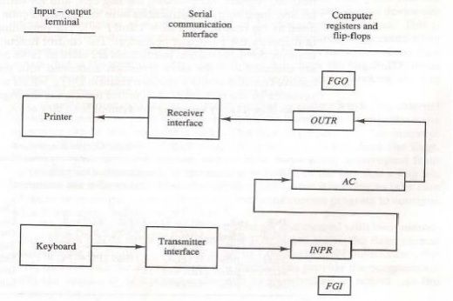
Input-Output Configuration

Slide 5
The input register INPR consists of eight bits and holds alphanumeric input information.
The 1-bit input flag FGI is a control flip-flop.
The flag bit is set to 1 when new information is available in the input device and is cleared to 0 when the information is accepted by the computer.
The output register OUTR works similarly but the direction of information flow is reversed.
Initially, the output flag FGO is set to 1.
The computer checks the flag bit; if it is 1, the information from AC is transferred in parallel to OUTR and FGO is cleared to 0.
The output device accepts the coded information, prints the corresponding character, and when the operation is completed, it sets FGO to 1.

